Slide 1
The Geospatial Architecture Database
Group 15: Oscar Puente, Brandon Stewart, and Ethan Sklar

Slide 2
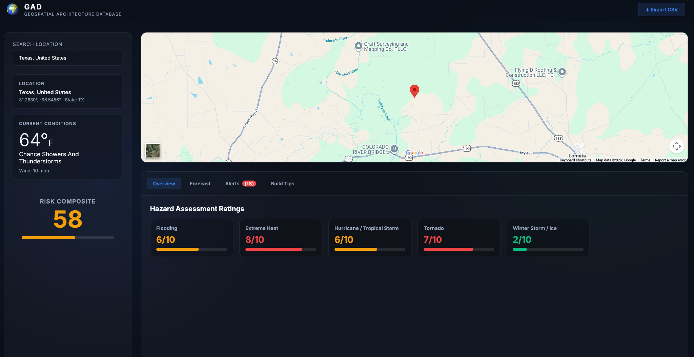
Project Overview
Geospatial Architecture Database
▸ Objective: provide hazard analysis and construction recommendations to help determine an ideal build site using geospatial data to project managers, architecture students and so on.
▸ Languages: Python, JavaScript, HTML
▸ Styling CSS.
▸ Frameworks/Libraries: Flask
▸ Version Control: Git.
▸ Software Tracking: GitHub.

Slide 3
The Prompts
Prompt 1
Prompt 2
Prompt 3
Initial Flask + frontend skeleton
Prompt: Build a Flask application that serves a single-page web app from frontend/index.html. The Flask app should live in backend/app.py with /api/* routes, and the static frontend (HTML, CSS, JS, no build step) should live in frontend/. Use a sidebar/map/dashboard three-column layout: search input + site metadata in the sidebar, an interactive map in the main panel, and a tabbed data view (Overview, Forecast, History, Alerts, Risk Score, Build Tips) below the map. Default port 5001 to avoid macOS AirPlay collisions; allow PORT env override.
Output: app.py with a basic route table (/, /api/health, /api/search stub), index.html with the three-pane layout, app.js with tab-switching logic, styles.css with a glass-morphism theme and CSS Grid layout. No external API calls yet.
Validation: Manual smoke test — booted the server, confirmed the page rendered with all six tabs clickable and the layout responsive at three viewport widths (1440px, 1024px, 600px).
State hazard profiles + IECC zones + building codes
Prompt: Create a Python module backend/db/seed_data.py with three reference dictionaries: STATE_PROFILES (51 states + DC, each with hurricane/tornado/flood/winter/heat/seismic/wildfire scores 0–10, sourced from NOAA Storm Events and FEMA hazard summaries); IECC_ZONES (per-state IECC climate zone, e.g. FL = "1/2", AK = "7/8"); BUILDING_CODES (per-state adopted IBC year and label, e.g. "FBC 2023 (IBC-based)"). Hand-curate — do not scrape.
Output: A 250-line seed_data.py with all three dicts populated for 50 states + DC. Sources cited in inline comments (NOAA Storm Events, FEMA National Risk Index summaries, ICC code adoption tracker).
Validation: Wrote a test that asserts every state code appears in all three dicts — caught a missing DC entry in STATE_PROFILES on first run; fixed before commit. Test now lives at tests/test_routes.py::test_history_covers_all_us_states_and_dc.
Construction recommendations per hazard category
Prompt: Add CONSTRUCTION_TIPS to seed_data.py: a dict keyed by the seven hazard categories (hurricane, tornado, flood, winter, heat, seismic, wildfire), each value a list of 3–6 short engineering-grade recommendations. Examples: hurricane should mention impact-rated glazing, hurricane straps, FEMA P-320 safe rooms; flood should mention finished floor elevation above the BFE, flood-vent calculation per ASCE 24; seismic should mention ASCE 7 design category, foundation anchorage. Cite FEMA / ICC / ASCE standards in the recommendation text where appropriate.
Output: CONSTRUCTION_TIPS dict with ~30 total recommendations across the seven categories. Each tip 1–2 sentences, written in the imperative voice ("Use impact-rated glazing per...").
Validation: Cross-checked sample tips against FEMA P-320 (safe room standard) and ASCE 24 (flood design) PDFs. Three tips were rephrased after the cross-check to remove a misattribution to ASCE 7 that should have been ASCE 24.

Slide 4
System Structure
Presentation Layer
Interactive frontend displays maps, hazard data, and analysis results through API requests.
Application Layer
Flask controllers and services orchestrate data retrieval, hazard analysis, map layers, recommendations and exports
Persistence Layer
SQLAlchemy/DAO layer stores users, locations, hazard data, analyses, sessions and reports in PostgreSQL/PostGIS

Slide 5
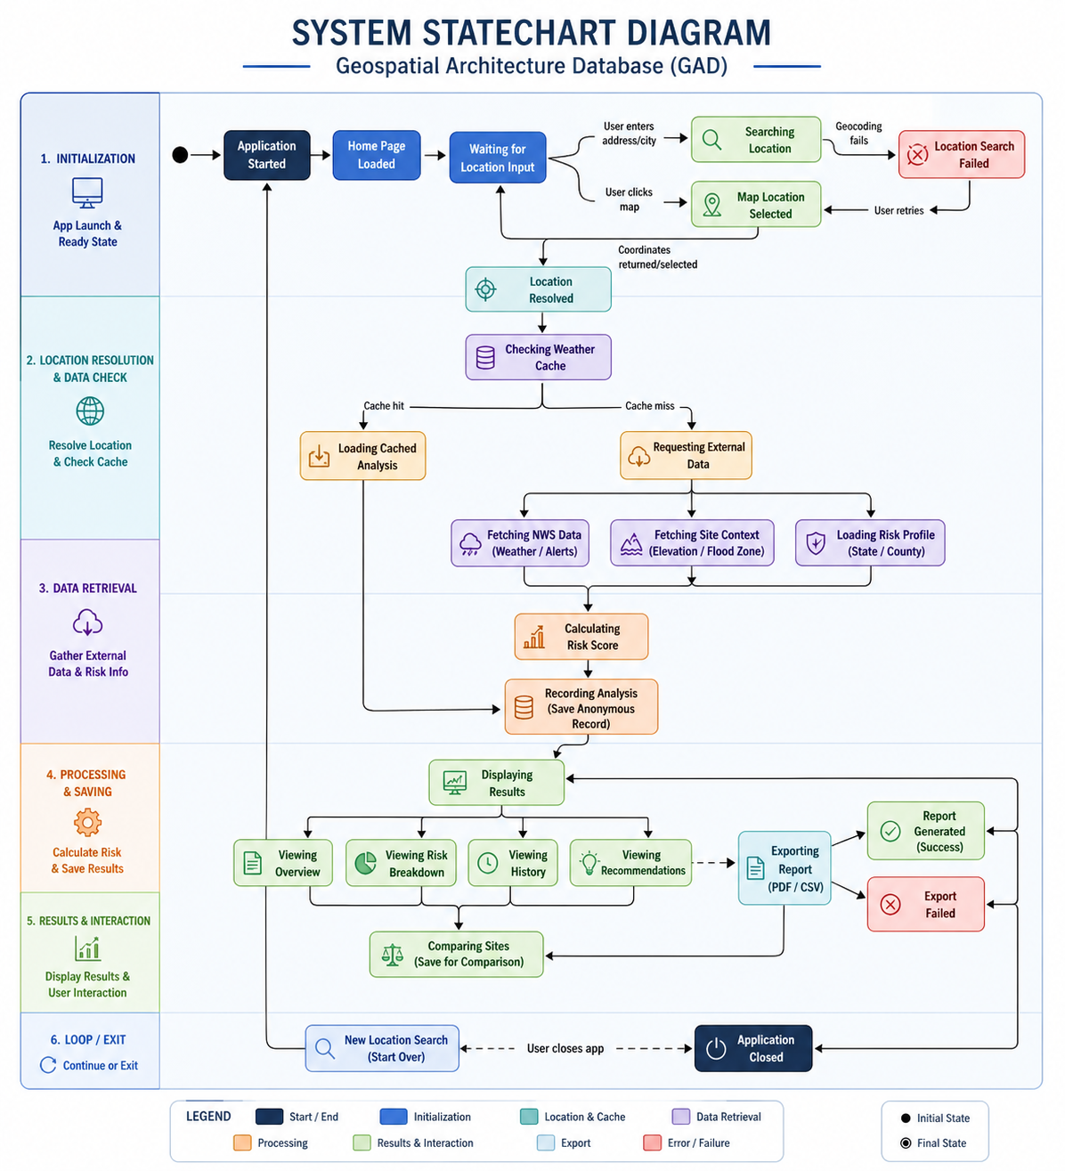
System Statechart Diagrams
This diagram represents the dynamic workflow of the GAD system during user interaction. It shows how the application transitions between states such as location input, data retrieval, risk calculation, result generation, report exporting, and system exit while managing external API requests, caching, and user-driven actions

Slide 6
External API & Data Source
Forward and Reverse Geocoding
NWS API
Forecast, active weather alerts, country zone IDs
Openstreetmap Nominatim
Ground Elevation for site context
USGS Elevation API
Forward and Reverse Geocoding
FEMA NFHL / NRI
Flood Zone and county-level hazard reference data
▸These external API’s are critical and meaningful for GAD as the risk analysis provide live and authoritative environmental context, keeping users assessments up to date.

Slide 7
Acceptance Test Cases
▸ Location Search: user enters a city/address, and received matching locations.
▸ Weather Analysis: selecting coordinates return forecast, alerts, scores, and site context.
▸ Risk DashBoard: frontend displays composites scores, hazard breakdown , recommendations, and . history.
▸ Report Export: user exports the selected site analysis as PDF or CSV.
▸ Failure handling:invalid coordinates, API failures, and export errors return clear messages.

Slide 8
Future Improvements
▸ Refactoring our code
▸ User Profiles
▸ AI integration
▸ Additional datasets and hazard models.

Slide 9
Conclusion
▸Our group successfully developed GAD a full-stack environmental risk analysis platform. Integrating real-world API’s, database system, backend services, and frontend visualization. Essentially establishing a strong foundation for future expansion into advanced simulation and infrastructure planning system.
Questions?

